Slide 1
The impact of agricultural devAid and FDI on Nutrution
Bryce
Carine
Milika
Zeinabou

Slide 2
Introduction
What is Food Security?
Globally 821 people suffered from hunger in 2018 (UN).
Global population to feed by 2050: 9 Billion People.
Causes of food insecurity:
Fast population growth
Climate change
Water scarcity
Higher costs of farming
Political Instability
Notes:
Food Security is a situation "...when all people, at all times, have physical, social and economic access to sufficient, safe and nutritious food to meet dietary needs for a productive and healthy life" (UN, 2014)

Slide 3
Context
Policy makers committed to end hunger by 2030
Sustainable Development Goals
Zero Hunger Challenge
More investment into agricultural sector
Partnership among stakeholders & Farmers

Slide 4
Question & Hypothesis
Question:
How does the source of net flows of agricultural capital flows influence the availability of food in countries of West Africa?
Hypothesis:

Slide 5
Methodology

Slide 6
Data Description

Slide 7
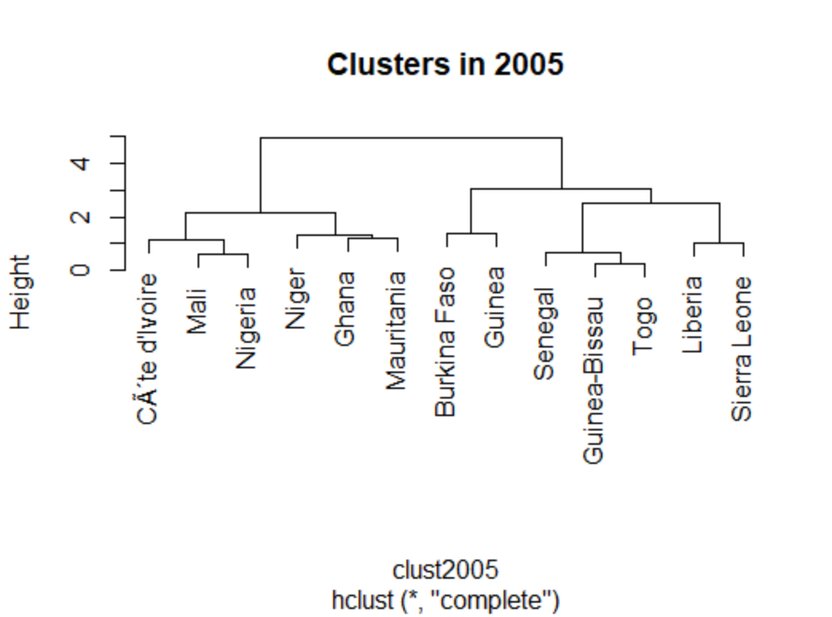
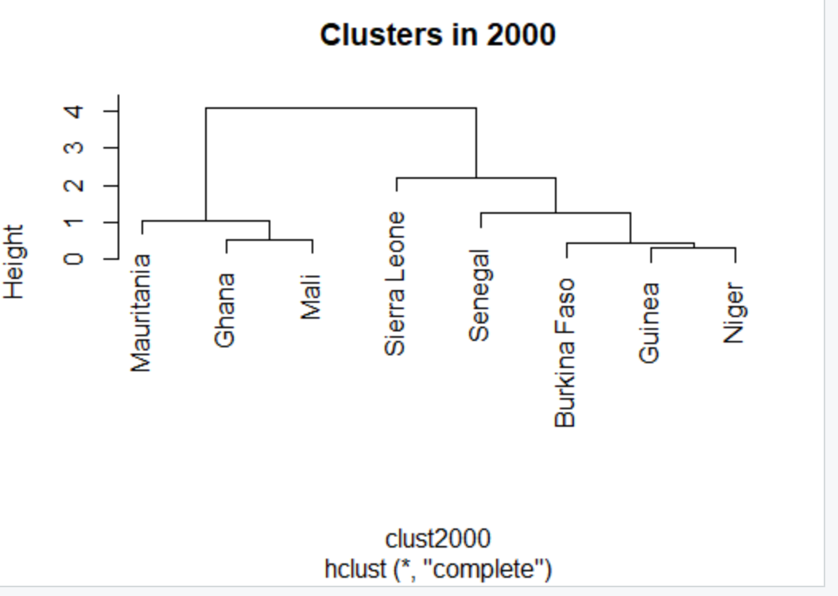
Agglomerative Cluster

Slide 8
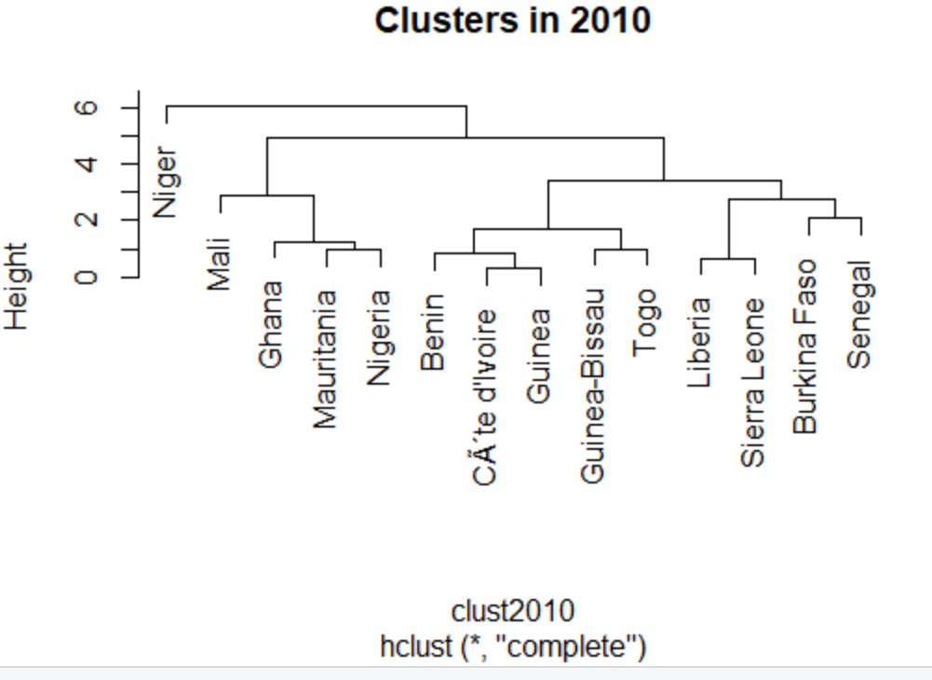
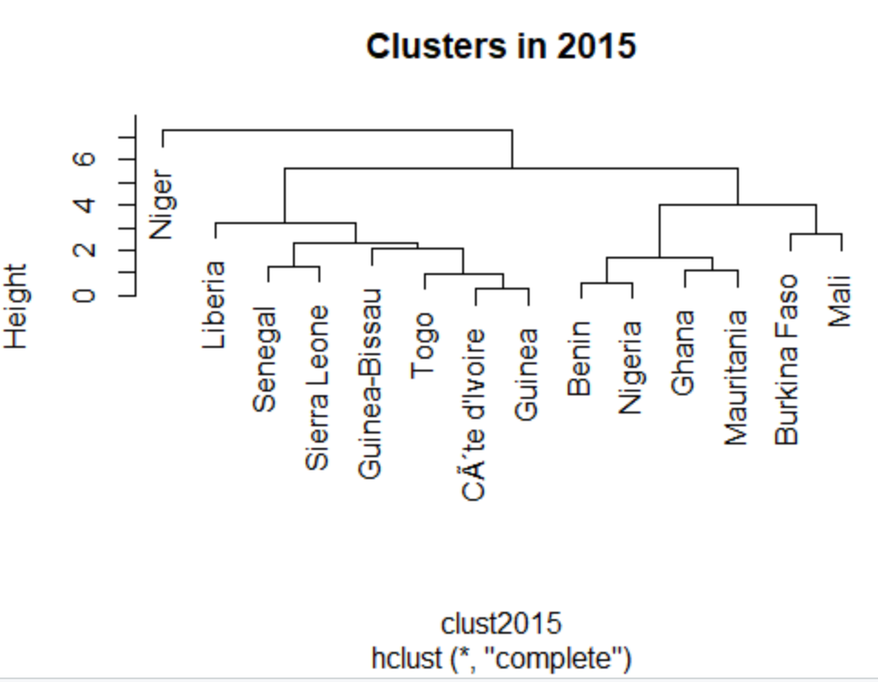
Agglomerative Cluster

Slide 9
Cluster Analysis
Countries moved further apart from each other over the years of analysis.

Slide 10
Results

Slide 11
Conclusion and Recommendation

